Slide 1
The Process of Communication
A scientific model

Slide 2
Activity
The following slide lists the elements involved in the process of communication. In what order will the appear in any single act of communication. Remember, there can be two possible patterns.

Slide 3
The Elements
Decoding
Sender
Feedback
Receiver
Message
Encoding
Channel

Slide 4
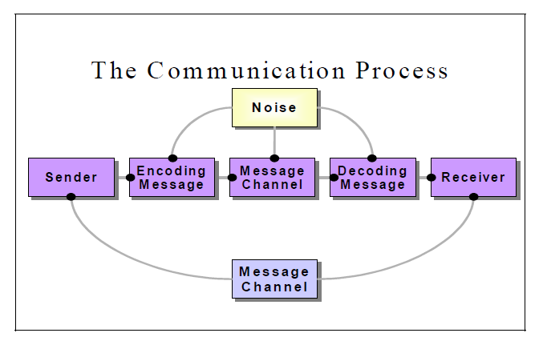
The process of Communication

Slide 5
Lets Study the Elements in Detail

Slide 6
1. SENDER
The person/entity who sends messages.
Senders have a background of accumulated attitudes, experiences, skills, cultural conditioning, and individual differences that influences how they communicate.

Slide 7
MESSAGE
It is the idea or feeling that the sender wants to communicate.

Slide 8
OBJECTIVE OF COMMUNICATION
All communication is motivated and initiated by clear objectives which can be
  information
  education
  persuasion
  motivation
  instruction
  raising morale
  advice and so on

Slide 9
ENCODING
Encoding is the process where the information you would like to communicate gets transferred into a form (words or signs) to be sent and decoded by the receiver.
Encoding is a complex activity.
Encoding must happen after considering the objective of communication, the receivers, the channel and the context.

Slide 10
Activity
ABS Corp is an organization that has been around for ten years. It has revised its Medical Leave Policy. The allowable medical leaves have been cut down from 10 to 5 days. This message has to be delivered to the employees ASAP. How will they compose the message?

Slide 11
CHANNEL
The channel is the means or technique used to convey the message, like, a conversation, telephone call, radio, television program, etc.

Slide 12
THE RECEIVER
The receiver is the target recipient of the message.
It is important to understand that receivers have to engage in a whole process to receive messages.
Receivers decode messages after active listening.

Slide 13
THE RECEIVER
Receivers decode or interpret messages under the influence of
    Self Concept
    Experience
    Expectations
    Attitudes and values
    Cultural, social, religious, and educational background
    Feelings
    Intellectual level, age

Slide 14
FEEDBACK
It is the receiver’s response to the sender’s message. Feedback is the main component of communication process as it permits the sender to analyze the efficacy of the message. It helps the sender in confirming the correct interpretation of message by the decoder. Feedback may be verbal (through words) or non-verbal (in form of smiles, sighs, etc.). It may take written form also in form of memos, reports, etc.

Slide 15
FEEDBACK
Feedback is important as it
  Provides continuity in communication
  Indicates effective understanding or misunderstanding of the message
  Stimulates further communication and adds discussion
  Can sometimes hinder communication

Slide 16
FEEDBACK
It can be both constructive or destructive in business settings.
How should a manager respond to a poorly written proposal by an employee?

Slide 17
CONTEXT
Context is the situation or setting within which communication takes place. It plays an extremely important part in how a message is encoded and decoded.

Slide 18
Activity
If the employees of ABS Corp are unhappy with the new Medical Leave Policy, how should they voice their opinion?

